Slide 1
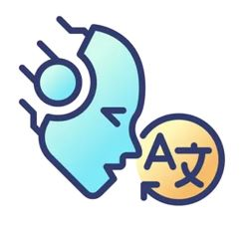


SPEAKEZ
AI Language Translator
Kaali Lovell | Pavan Polireddy | Rakesh Tirumala
Steve St Fleur | Tanvi Prakash Gavali | Venkat Sai Pallapu

Slide 2

AGENDA
1
Our Team
2
Project Overview
3
Languages and Tools
4
Team Management
5
Retrospective

Slide 3
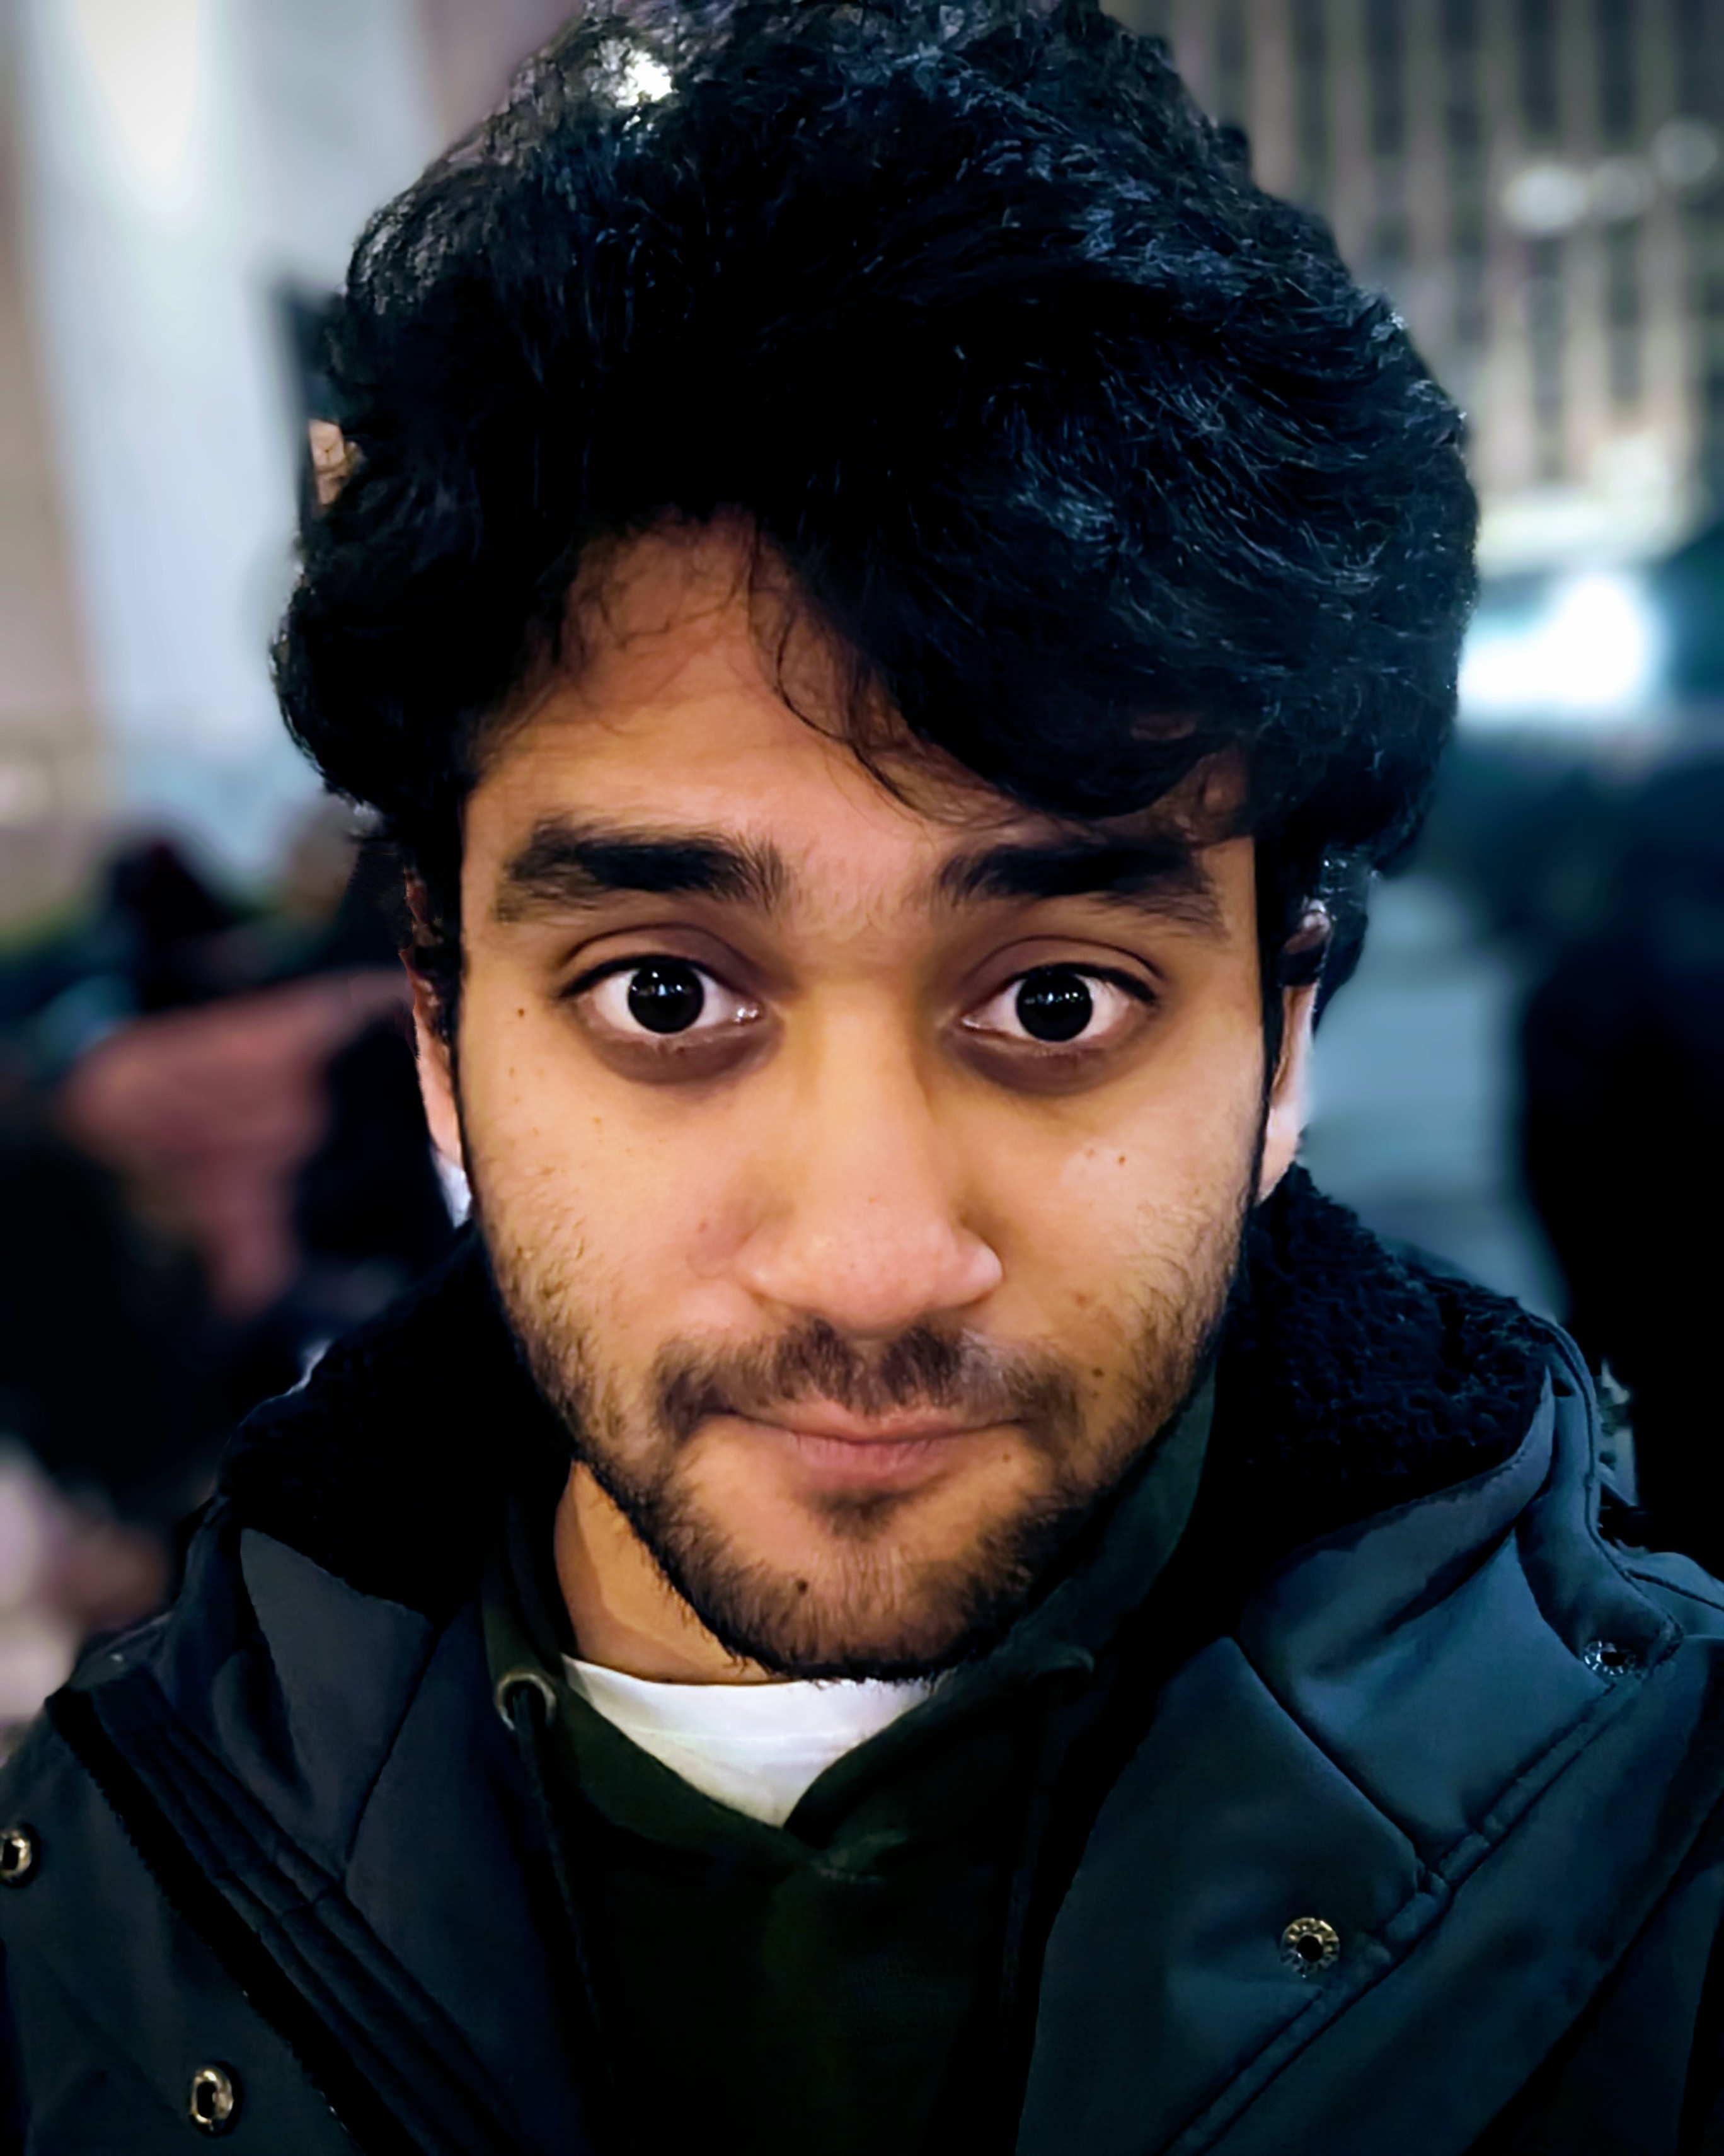
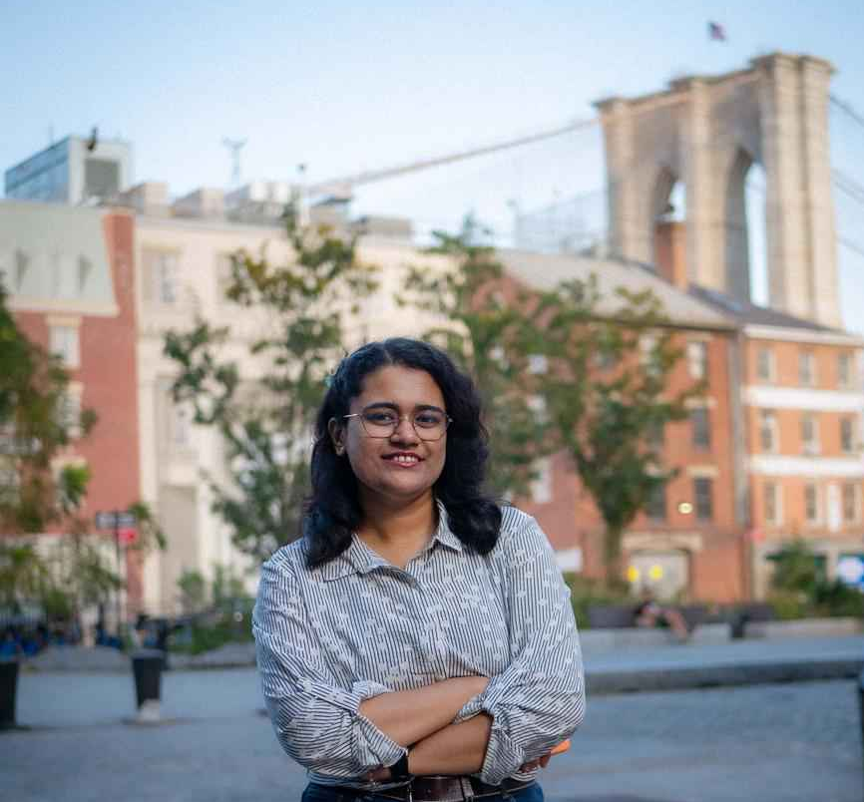
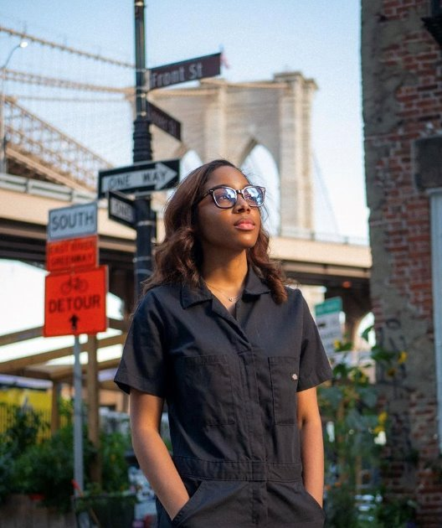
TEAM ROLE & RESPONSIBILITIES
Rakesh Tirumala
Team Leader
Tanvi Prakash Gavali
Scrum Master
Kaali Lovell​
Tester/ Product Designer

Slide 4
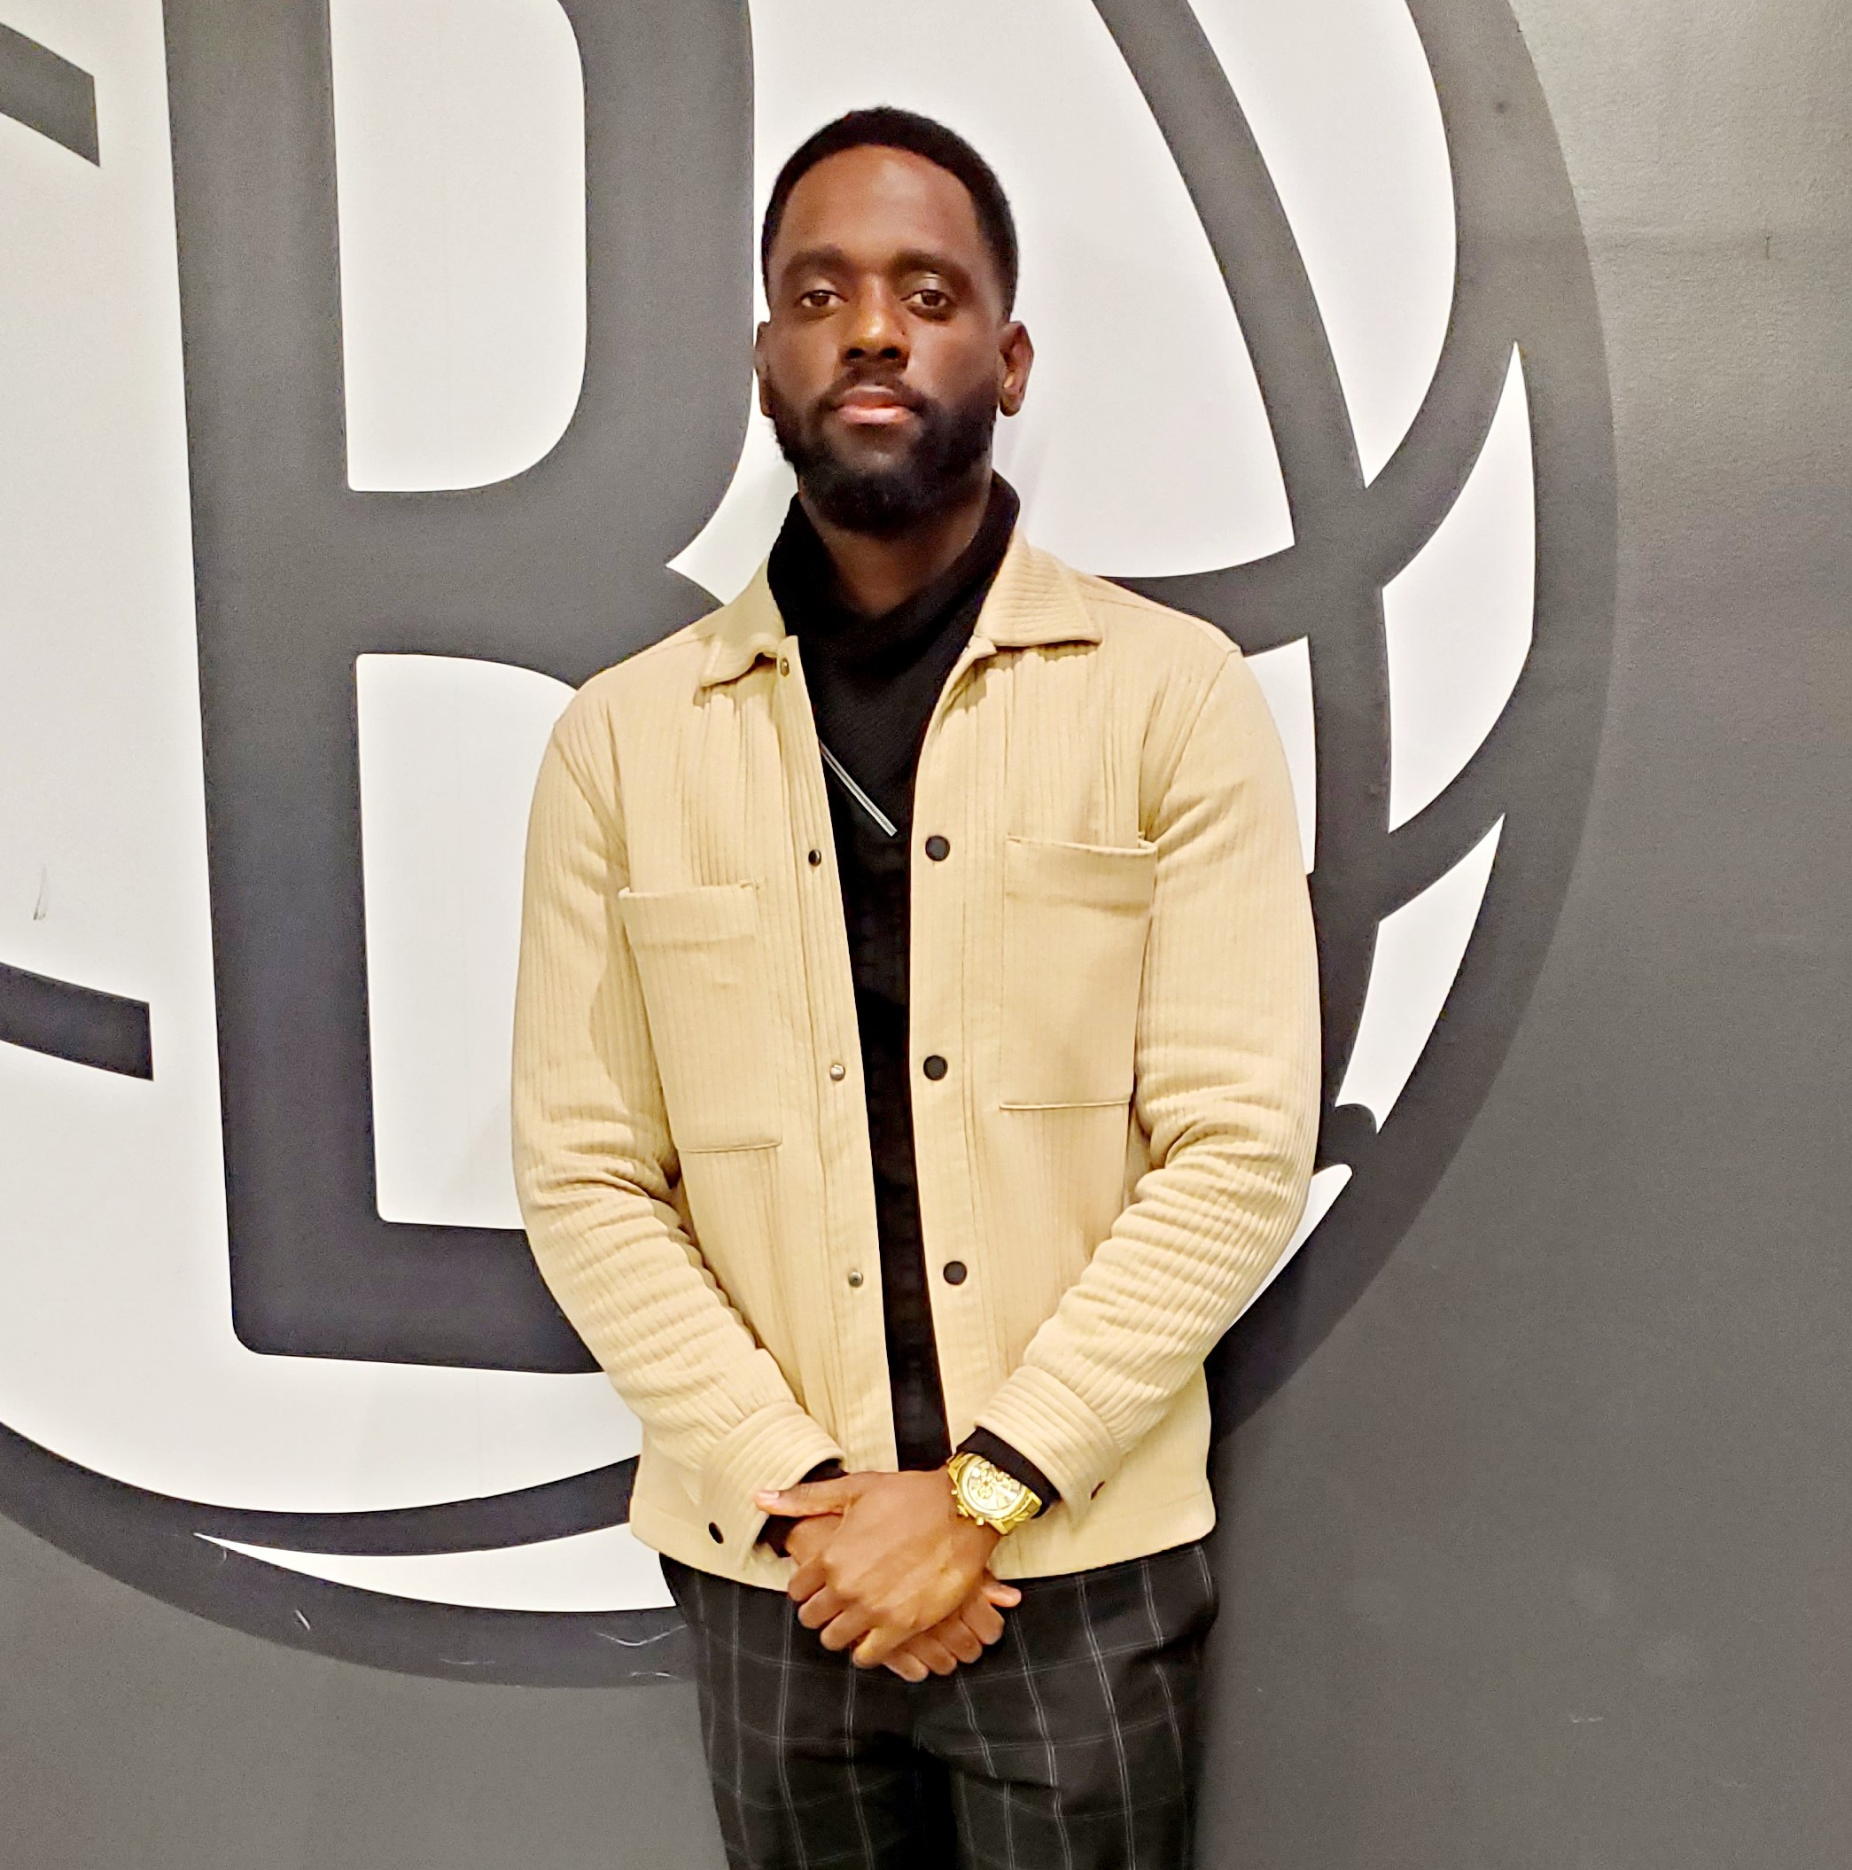
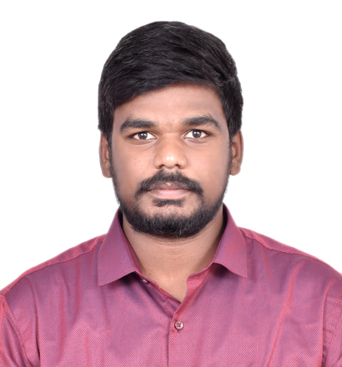
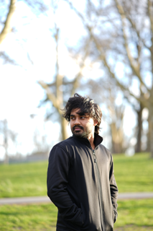
TEAM ROLE & RESPONSIBILITIES
Steve St Fleur
Fullstack Developer
Venkat Sai Pallapu​
Fullstack Developer
Pavan Polireddy
Fullstack Developer​

Slide 5

PROBLEM STATEMENT
Understanding foreign languages is often a challenge, as each language has its own unique structure, nuances, and meanings. Effective communication with native speakers becomes difficult without proper understanding, yet mastering every language is nearly impossible. To address this issue, we aim to create an application that helps bridge the communication gap by converting audio into transcriptions in multiple languages, enabling people to understand and engage in conversations more easily.

Slide 6

PROJECT DESCRIPTION
Our project will be an AI integrated web application to help users communicate across different languages. The application will have a user friendly interface, allowing users to either upload pre-recorded audio files or use live recordings to generate accurate transcriptions in any desired language.

Slide 7

PROJECT DESCRIPTION
To achieve this, we are integrating advanced AI models, capable of understanding the input language and seamlessly translating it into the required language. The application will be accessible from all devices. Our goal is to break down language barriers and facilitate effortless communication across cultures and regions.

Slide 8

PERSONAS

Slide 9
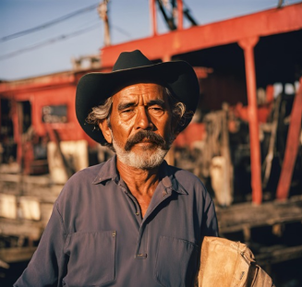
JOSÉ RODRIGUEZ, DOCKS WORKER
Demographics:
Age: 53
Gender: Male
Location: Louisiana, USA
Education: High school diploma
Experience: 15+ years
Skills and Qualifications:
Forklift License
Management in handling and securing cargo using forklifts
Excellent team worker, organized, and physically capable
Goals and Needs:
José is originally from Mexico but has relocated to USA for better working opportunities for his children. He can understand very little English as most of his coworkers speak Spanish as well. During his old age, he started having frequent visits to the doctors where they speak in English with him, which he has difficulty understanding. He does not want to burden his children with the task of translating, and wants to retain confidentiality between himself and his doctor. It is also expensive to hire professional translators - beyond his budget. Jose is looking for an application where he can converse with the doctors without any communication hindrances, and keep transcripts as part of his medical record - both before and after translation.

Slide 10
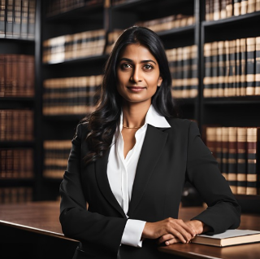
ANJALI CHITRE, LAWYER
Demographics:
Age: 27
Gender: Female
Location: Edinburgh, UK
Education: LLM in International Law
Experience: 4+ years
Skills and Qualifications:
Skilled in conducting in-depth research regarding international legal issues
Proficient in explaining legal concepts and mediating in legal cases
Professional, showcasing confidence and problem solving skills.
Goals and Needs:
Anjali’s job is to provide legal advice to multinational corporations who need to comply with different regulations for both their U.K and Swedish subsidiaries. To not disclose business information and legal strategies to a 3rd party, Anjali would like an application which can transcribe and translate discussion during meetings without breaching confidentiality or having to create further confidentiality agreements with translators.

Slide 11

NICOLE SCHULER, EXECUTIVE ADMINISTRATIVE ASSISTANT
Demographics:
Age: 27
Gender: Female
Location: Toronto, CA
Education: Bachelors of Business Administration (BBA)
Experience: 1 years
Skills and Qualifications:
Proficient in Excel, Microsoft Office, Outlook, Google Workspace
Certified Administrative Professional (CAP)
Excellent organizational, administrative, and interpersonal skills
Goals and Needs:
Nicole is originally from NYC but has relocated to Canada for work. Nicole has to attend daily meetings and transcribe the meetings for her higher-ups. Some of her co-workers switch between French and English in the meetings which frustrates Nicole since her native language is English and she has no experience with French. Nicole is looking for a tool that will help her efficiently transcribe the meetings and also assist with translating the French terms.

Slide 12
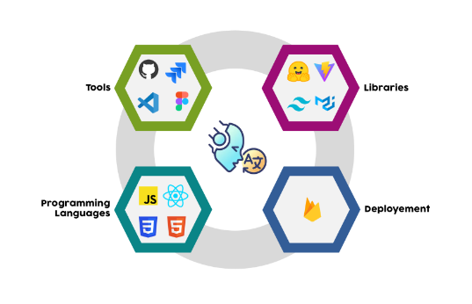
TECHNOLOGIES

Slide 13

ALGORITHMS
The application should be able to take audio as input and convert it into the desired language. To achieve this, we need an AI model for automatic speech recognition and speech translation. So, the most suitable neural network to use in order to perform this task is a Transformer.

Slide 14
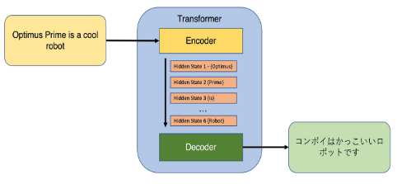
ALGORITHMS
A transformer is a neural network architecture especially designed for processing sequential data like natural language processing (NLP).
They usually use an encoder-decoder structure but make use of attention mechanism in order to capture relationships between elements in a sequence. Unlike RNNs, transformers process data in parallel which makes them faster and more scalable.

Slide 15
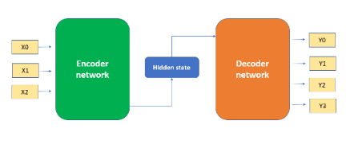
ALGORITHMS
In the encoder-decoder structure, the encoder processes the input data, which can be text, audio, etc., and generates encodings. The decoder takes these encodings, uses the derived context, and generates the output sequence.

Slide 16
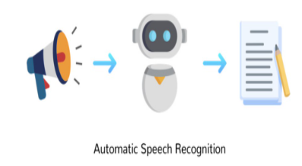
ALGORITHMS
Whisper is a transformer based on the encoder-decoder structure. It was trained on 680,000 hours of labelled speech data. The model can perform both speech recognition and speech translation.

Slide 17
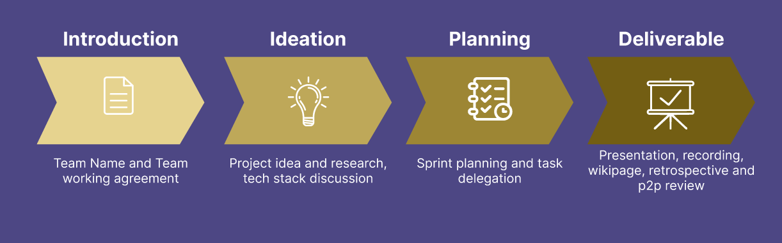
Timeline

Slide 18
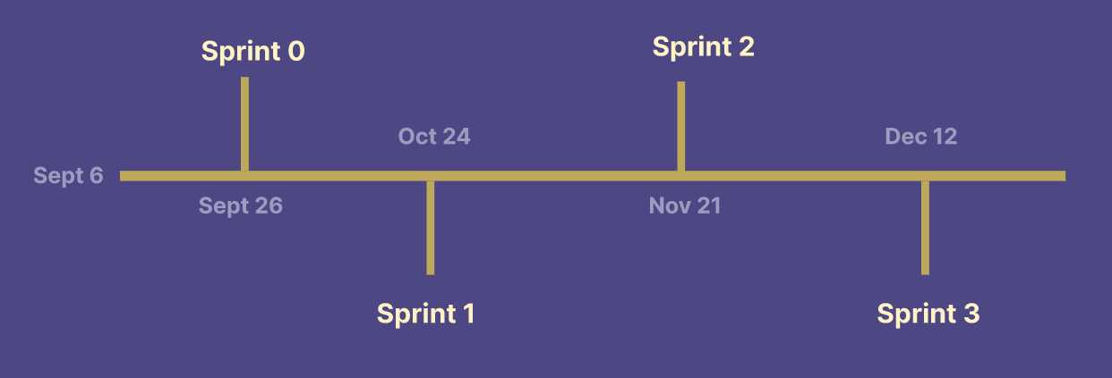
PROJECT SCHEDULE

Slide 19
TEAM WORKING AGREEMENT
Communication:
The team will communicate with each other through Zoom and WhatsApp.
Google Docs will be utilized for collaborative document editing, sharing resources, and taking notes during team discussions.
Team members should alert the team in advance if they are unable to join a Zoom meeting.
Team members are expected to provide regular updates on task progress and promptly communicate any obstacles or delays to the group.
Team members are encouraged to actively participate in discussions, providing feedback and support as needed.
During all discussions, team members should listen carefully, speak clearly, and stay on topic to avoid confusion
Each team member should complete all assigned work before the deadline. If they are struggling with a task, they should contact the team as soon as possible to resolve the issue. Failure to complete work before the deadline can negatively affect the team’s project timeline.

Slide 20
TEAM WORKING AGREEMENT
Work Division & Participation:
Jira, and GitHub will be used to track and divide all tasks.
The entire project should be divided into equal parts, and all team members should be given equal responsibility.
If a team member is not participating to the level the other members are, the team leader is permitted to assign necessary tasks to that member.
Each team member is responsible for their assigned tasks and their contribution to the overall success of the project.

Slide 21
TEAM WORKING AGREEMENT
Meetings:
Regular team meetings will be scheduled twice a week on Sundays at 2:00 pm and Thursdays at 5:30 pm via zoom to review individual and collective progress. Failing to join these meetings will negatively affect the group.
If unable to attend a scheduled meeting, team members should inform the group in advance.
In urgent situations, additional meetings may be arranged with at least 24 hours’ notice.
Meeting agendas will be sent at least 24 hours prior to the meeting.
Meetings will commence and conclude on time, with members expected to join 2 minutes prior to the start.
All team members are required to have their Zoom cameras open during the meetings. They are required to show respect, actively listen, and participate by sharing feedback or suggestions.
Team agrees to follow these agile practices throughout the project:
Meet at the beginning of each sprint to discuss tasks for the upcoming sprint.
Meet at the end of each sprint to present the completed work and gather feedback.

Slide 22
TEAM WORKING AGREEMENT
Respect and Professionalism:
All communication and interaction within the team will be conducted with respect; diverse viewpoints and inputs should be appreciated.
Feedback should be constructive and centered on the project and not on personal traits.
If a member disagrees with a decision, they can request a review at the next team meeting.
The team aims to create a welcoming space where everyone feels comfortable sharing their ideas
Any disagreements should be addressed openly and respectfully within the team. If an internal resolution is not possible, the team will seek advice from the professor.

Slide 23
TEAM WORKING AGREEMENT
Definition of Done (DoD) for the Language Translator App:
The translation and transcription feature works as intended and meets all acceptance criteria and requirements.
The app successfully translates text between the specified languages without errors.
The app successfully transcribes speech to text.
Codes have been reviewed and approved by all team members.
The app has been manually tested for usability and performance.
Codes are documented with comments where necessary.
User guide and technical documentation have been updated accordingly.
The app is deployable and runs without issues.

Slide 24
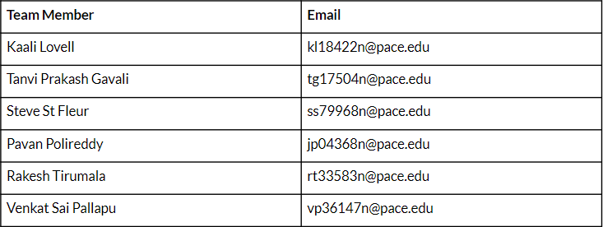
TEAM WORKING AGREEMENT

Slide 25
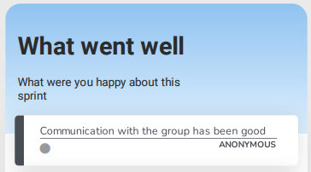
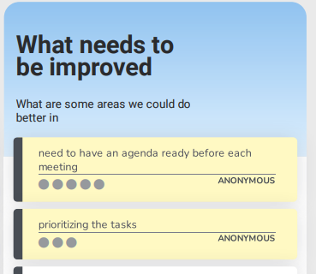
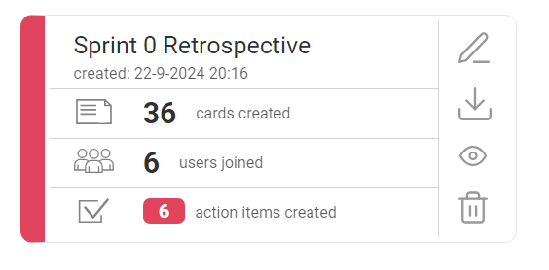
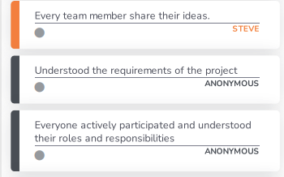
RETROSPECTIVE

Slide 26
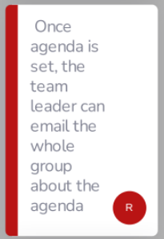
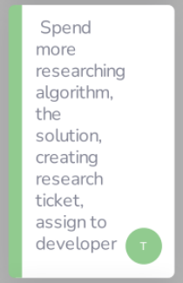
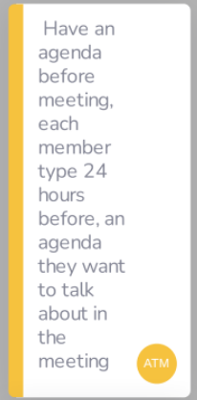
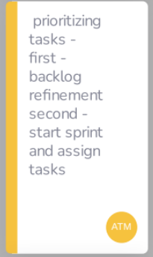
RETROSPECTIVE – Action Item
https://www.youtube.com/watch?v=M4Yp9ZFU2RU&t=81s

Slide 27
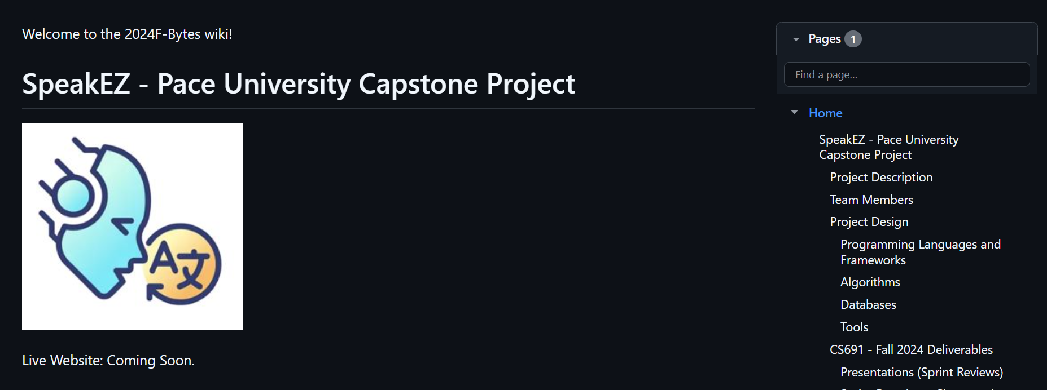
WIKIPAGE LINK
https://github.com/htmw/2024F-Bytes/wiki

Slide 28

THANK YOU!
Do you have any questions?

